Slide 1
Letting Behaviorism Help Shape Your Teaching
Brian Bird
GCC Math Faculty
Spring 2018

Slide 2
What is Behaviorism?
behaviourism behaviorism be·hav·ior·ism bəˈhāvyəˌrizəm
Noun PSYCHOLOGY
the theory that human and animal behavior can be explained in terms of conditioning, without appeal to thoughts or feelings, and that psychological disorders are best treated by altering behavior patterns
https://www.google.com/search?q=Dictionary#dobs=behaviorism
a school of psychology that takes the objective evidence of behavior (such as measured responses to stimuli) as the only concern of its research and the only basis of its theory without reference to conscious experience
https://www.merriam-webster.com/dictionary/behaviorism

Slide 3
Famous Behaviorists
Ivan Pavlov 1849-1936
Russian Scientist
Edward L. Thorndike 1874-1949
American Psychologist
John B. Watson 1879-1958
American Psychologist
B.F. (Burrhus Frederic) Skinner 1904-1990
American Psychologist

Slide 4
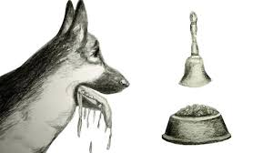
Pavlov
Classical Conditioning
Studying Digestion in Mammals
Food (Unconditioned Stimulus -- US) produces Saliva (Unconditioned Response -- UR)
Bell/Lab Coats (Neutral Stimulus --NS)
Present Bell/Lab Coats with Food and dogs learn to associate
Bell/Lab Coats become Conditioned Stimuli (CS) and Saliva becomes Conditioned Response (CR)

Slide 5
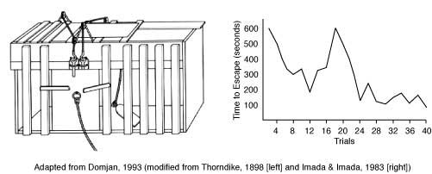
Thorndike
Operant Conditioning
Learn by consequences of behavior
Law of Effect
behavior → reward → repeat
behavior → punishment → don’t repeat
Cats in Puzzle Box

Slide 6
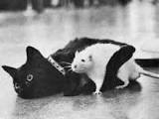
Watson
Against Freudian notions that our unconscious mind was behind most of our behavior
Classical Conditioning with Humans
Little Albert
Rats&Cats (NS)→ No Fear(UR)
Rats&Cats associated with Loud Noise (US)→Fear (UR)
Rats&Cats (CS)→Fear (CR)

Slide 7
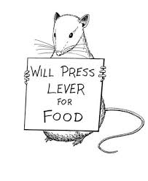
Skinner
Operant conditioning. A behavior is followed by a consequence, and the nature of the consequence modifies the subject’s tendency to repeat the behavior
Studied rats in cage “Skinner Box”
Push lever → gets food
Push lever→ gets shock
Law of Effect (like Thorndike)
behavior → reward → repeat
behavior → punishment → don’t repeat

Slide 8
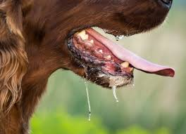
Can we make our students salivate?
Do we wear a lab coat or ring a bell? No.
But what can we do?
When entering the classroom, have a catchphrase that you use each time that lets the students know it’s time to start. Examples:
“Time for math!”
“Good morning ladies, gentlemen boys and girls.”
“Who’s ready to think?”

Slide 9
Can we make our students salivate?
When asking a question that requires thinking and a response, have a common opener or closer that you tie-in with the question. Examples:
“I’ve got something to ask you.”
“This question is going to require some thought.”
“Think about that for a bit and get back to me.”
“Let’s mull that over.”

Slide 10

Can we make positive associations?
Make positive associations with you math experiences and your life. Examples:
“Getting my degree in math was the best thing that happened to me.”
“Teaching math at the community college is a dream job.”
“I like math because there is a right answer.”
“When I complete a hard math problem, I feel good about myself.”

Slide 11

Reward Examples
“The class participated so well today I will enter a 5 out of 5 quiz score in the grade book.”
“That’s an excellent answer. You will be excused from the quiz with a 100%.”
“Thanks to your participation, we will be able to get out of class a little early today.”
“That’s an excellent question. I will put one just like it on the test.”

Slide 12

Punishment Examples
“I think we are going to need to have a quiz tomorrow because there wasn’t enough meaningful participation today.”
“Looks like I’m going to have to make that test a little harder.”
“You were late for class, looks like you earned eraser duty.”
“Where is everyone today? Let’s have an attendance quiz.” (also a reward!)

Slide 13
References
https://www.simplypsychology.org/pavlov.html
https://study.com/academy/lesson/john-watson-and-behaviorism-theory-lesson-quiz.html
https://www.simplypsychology.org/edward-thorndike.html
https://www.learning-theories.com/operant-conditioning-skinner.html

